Slide 1
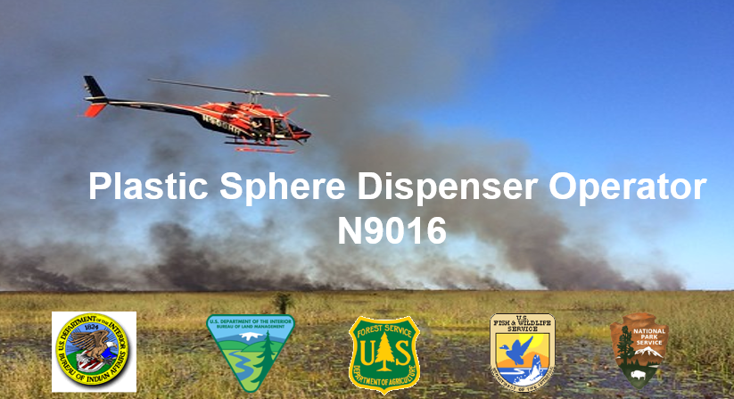
Plastic Sphere Dispenser Operator N9016

Slide 2
Course Logistics
Facilities
Course schedule – timeline, breaks, lunch
Student references
PMS 501
Device manual
Field exercise
Notes:
**Instructors are to customize the information in this slide for their specific location, classroom and training session information. Below are bullets for consideration.
INSTRUCTOR NOTE: Each student will need to have either a hard copy or have downloaded the following documents prior to class:
- NWCG Standards for Aerial Ignition guide PMS 501 and all required PSD forms
- PSD device manual(s) for each device training is being provided on
- Interagency Aviation Life Support Equipment Guide
*Instructors should consider having a mock scenario for students to engage with throughout the course; this could be a prescribed or wildland fire scenario. Provide students with a packet that includes: a completed MASP (prescribed or wildland fire), all PSD forms from Appendix A of the PMS 501, a completed load calculation, manifest or information sheet with positions, names, weights, etc. for the PLDO to be able to complete all forms and manifests required for a PSD operation.

Slide 3
Introductions
Name
Where do you work – agency and unit
Your position
How long have you been involved in helicopter operations?
Notes:
**Instructors are to customize the information in this slide for their specific location, classroom and training session information. Below are bullets for consideration.

Slide 4
N9016 Plastic Sphere Dispenser Operator Unit layout
N9016 Plastic Sphere Dispenser Operator
Unit 1: The History of PSD and Current Devices
Unit 2: Aerial Ignition Training, Responsibilities & Qualifications
Unit 3: Device Function and Maintenance
Unit 4: PSD Safety and Safety Considerations
Unit 5: Flight Preparation and Inflight Procedures
Unit 6: Fuels and Fire Behavior
Unit 7: Device Malfunctions and Emergency Procedures
Unit 8: Field Session

Slide 5
UNIT 1 - History of PSD and Current Devices
Unit Objectives:
Understand the history of the Plastic Sphere Dispenser (PSD)
Identify the approved PSD devices as stated in the NWCG Standards for Aerial Ignition PMS 501
Review the advantages and disadvantages of PSD in relation to helitorch operations
Notes:
This unit will cover the history and progression of PSD devices and the devices that are currently utilized in operations today.

Slide 6
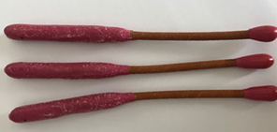
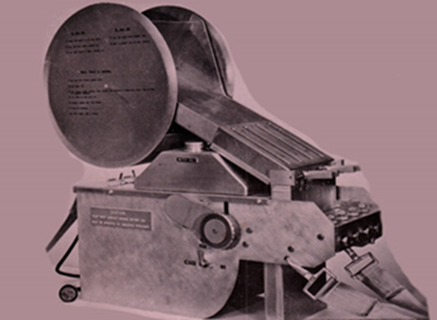
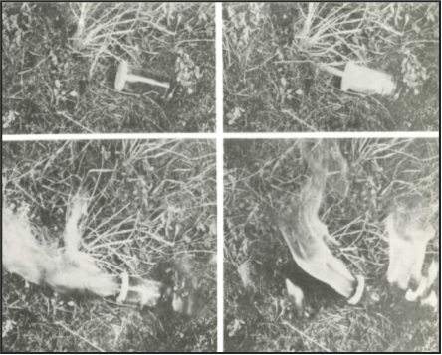
The History of PSD
Delayed Action Incendiary Device (DAIDs)
Development of dispensers
Pharmaceutical Vials
Notes:
The inception of aerial ignition began in the late 1960s in western Australia. The devices were developed to provide a method of igniting ground fuels, in a short time, on large acreage, without causing undue damage to the over story. This method was required to be cost effective, environmentally acceptable, and readily available.
Aerial ignition devices, which were first utilized with fixed wing aircraft, have been modified over the years to work on helicopter and unmanned aerial systems (UAS).
Pharmaceutical vials – (1972) Pharmaceutical vials containing potassium permanganate were hand injected with glycol via syringe. This caused an exothermic reaction (like today’s spheres) and then dropped from the aircraft. Their irregular size made it difficult to put them in devices for more efficient use.
DAIDs – 7” long device equipped with a 30 second safety fuse. Both ends of each DAID were coated with a modified match head compound, then a layer of high melting point wax to prevent accidental ignition when rubbing together in transit. A helicopter crash in Australia in 1978 discontinued the use of DAIDS
Dispensers – The Canadian Forest Service developed a more modern-day dispenser.

Slide 7
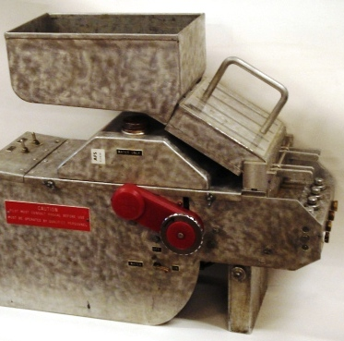
The History of PSD
Alberta Department of Land Management developed a Sphere container
PFRC developed the Dispenser
MKII
Notes:
Alberta Department of Lands took the vials developed in Australia and altered them to be consistent sized spheres made of polystyrene. The new spheres also contained a consistent amount of potassium permanganate. In 1977 the Alberta Department of Lands worked with the Pacific Forest Research Center (PFRC) to develop the Mark II.

Slide 8

Approved PSD Devices
PMS 501
Premo Mark III
SEI Red Dragon
PSDS Mark V (should be removed from service by 2027)
Raindance
UAS - Ignis
Notes:
Instructor note: Refer students to the PMS 501, Chapter 3 – Approved Aerial Ignition Devices. Review the approved devices, agency manufactured or modified devices and aerial ignition device approval process in this chapter.
Regardless of the device utilized, the basic function of all PSD devices are the same; the device injects undiluted ethylene glycol into a plastic sphere or capsule that contains a specific amount of potassium permanganate. The sphere or capsule is then ejected from the device, and after a time delay an exothermic reaction occurs, igniting the sphere.
Instructor Note: The Raindance device utilizes capsules instead of spheres and does not utilize glycol. Additional information is covered on this device in slide 11.

Slide 9
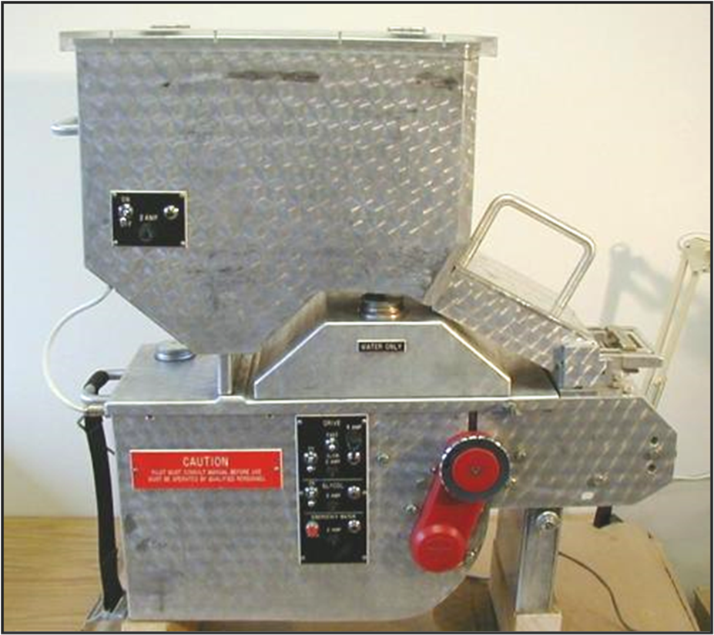
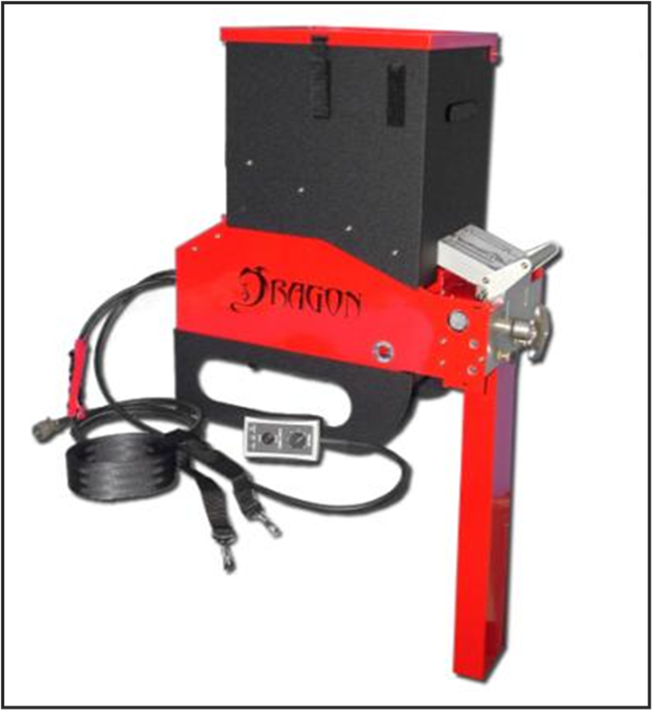
Common PSD devices used
Premo Mark III
Red Dragon
Notes:
The Premo Mark III and the Red Dragon are the most common manned PSD devices currently being utilized.
Premo Mark III was developed in the early 1980s and approved for use in 1986
SEI Red Dragon was developed in the early 2000s; it was approved for use in 2009.

Slide 10
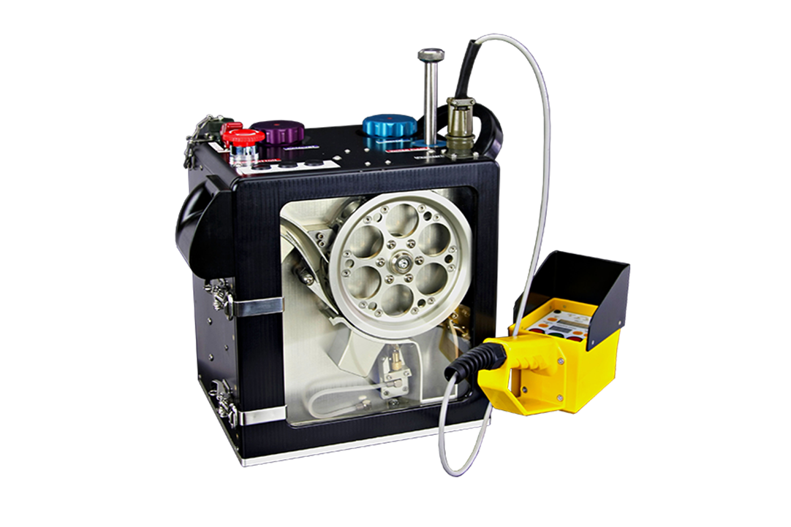
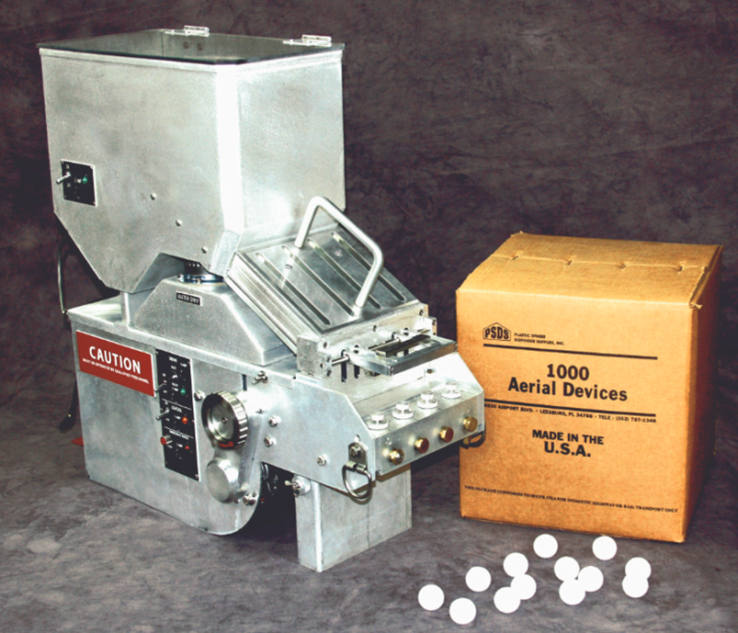
Other versions of PSD Devices available.
Raindance R3 Aerial Incendiary Device (AID)
Aerostat Mark V
New purchases unauthorized, remove from service by 2027!
Notes:
Aerostat Mark V – very similar to the Premo Mark III; the Mark V utilizes the same design concept and spheres as the Premo, but it weighs slightly less (93 lbs.). New purchases of this device are unauthorized; all Aerostat Mark V devices should be removed from service by 2027.
Raindance R3 Aerial Incendiary Device (AID) – the R3 utilizes PSD capsules as opposed to spheres, the capsules are attached together in a string and are fed into the device. It can drop anywhere from 6 to 240 capsules per minute. The device does not utilize ethylene glycol (antifreeze) like other devices, it instead utilizes the developing companies own “Purple Incendiary Catalyst” to create the reaction and ignite the capsule. The device is more commonly utilized in Australia.

Slide 11
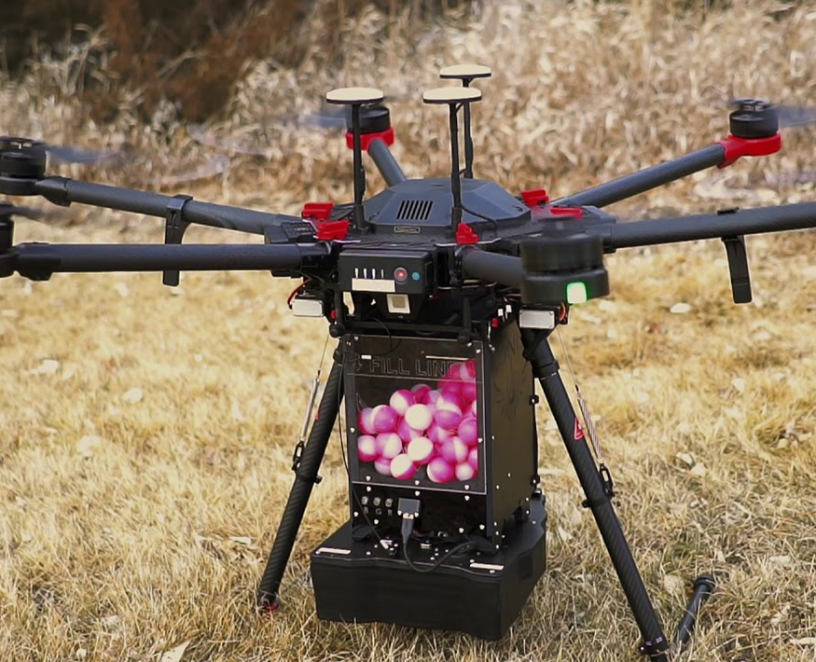
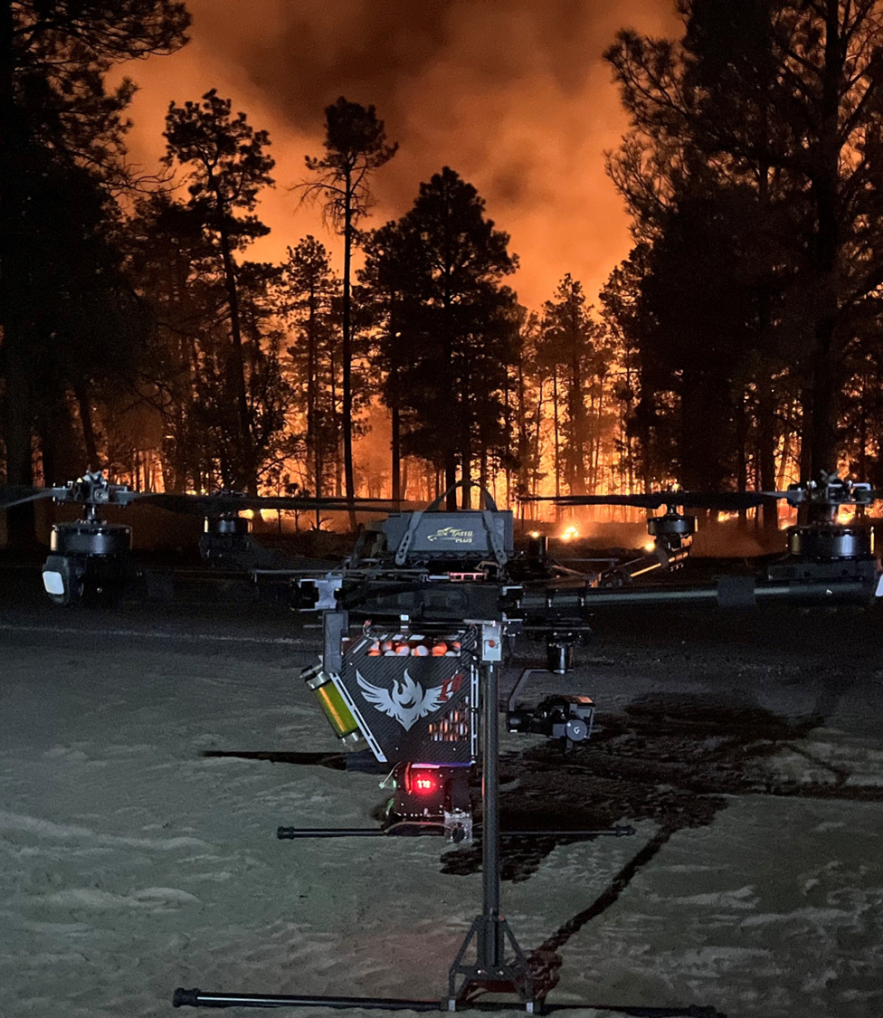
UAS - IGNIS
Notes:
UAS ignition capabilities –
30 minutes of flight time
Range varies with topography and fuel type. 1-2 nautical miles easy answer
The PSD device has the following features:
Uses standard Dragon Egg ignition spheres and full-strength antifreeze.
Current maximin load of 450 spheres, drop rate of up to 120 spheres per minute.
Future system will see 1,000 sphere – 4,000 sphere hoppers and increased flight times.
Note: Contact regional UAS specialist for more information

Slide 12
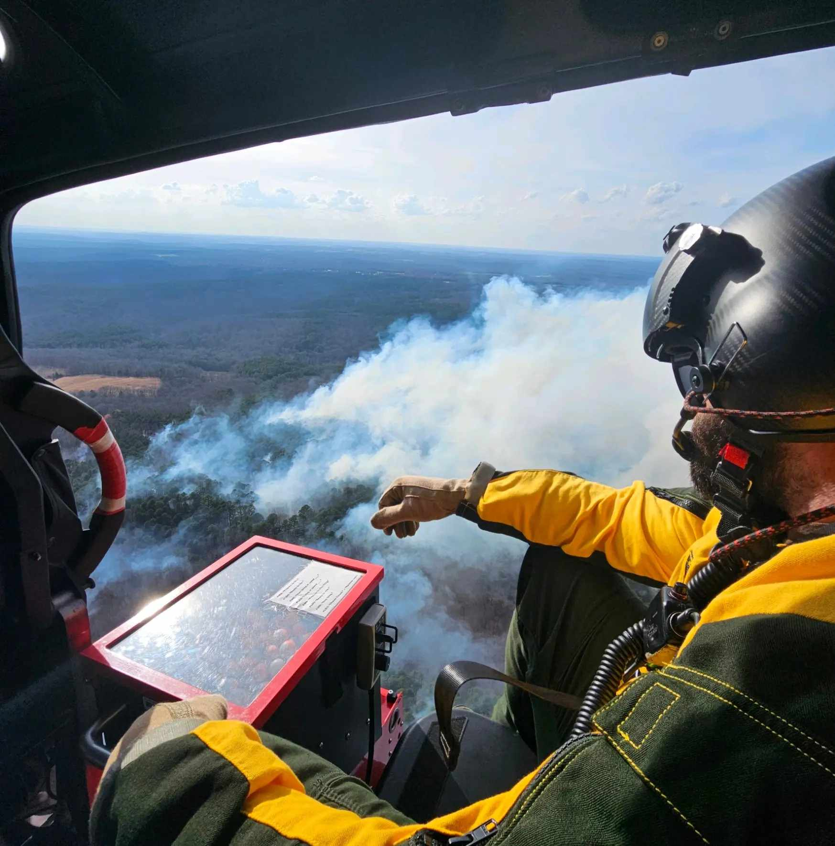
PSD vs. Helitorch
ADVANTAGES
Less Complex
Separate helibase not required
Safer transport and handling
Improved Control
Aerial Ignitions Supervisor onboard the helicopter
PLDO to assess and address device issues
PLDO can monitor number of spheres
Fire Behavior
Minimum damage to canopy
Ability to lay long ignition lines
Lower Cost
Less equipment and staff required
Notes:
Complexity:
-PSD operations can be configured and completed anywhere (i.e., helibase, helispot, etc.) whereas helitorch operations require a larger area to support all the equipment and personnel. Helitorch operations also requires its operating area away from other aircraft and personnel to ensure the safety of all personnel and equipment involved.
- PSD requires 2 additional personnel for aerial ignitions, where as helitorch needs at minimum 3 personnel
-The quantity and volatility of hazmat utilized for PSD operations is substantially less than that of helitorch operations.
Improved Control:
-Aerial Ignitions Supervisor (AIS) and PLDO can assist the pilot with identifying and staying within unit boundaries, as well as provide immediate feedback to the pilot on sphere spacing. The AIS can also communicate with ground personnel in the event a sphere is observed crossing the unit boundaries.
-The PLDO can troubleshoot the device whereas if there is an issue with the helitorch the pilot will need to return to the helibase.
-Throughout the flight the PLDO can identify the quantity of spheres remaining and provide that information to the AIS and pilot. The pilot does not have an accurate way to gauge the amount of gel remaining in the helitorch.
Fire Behavior:
-PSD spheres will fall through the canopy ( majority of the time), limiting damage to the canopy. All involved in PSD missions should recognize that as spheres drop; they may bounce and/or roll off ridges, rocks, etc. With the helitorch operations the gel will not readily drop through the canopy and will likely ignite the canopy.
Lower Cost:
PSD operations require less equipment and personnel to execute. Thereby making the initial startup and execution cost lower than helitorch operations. The PSD device also only utilizes spheres and glycol which are substantially cheaper compared to the use of fuel and mixing agent for helitorch.

Slide 13
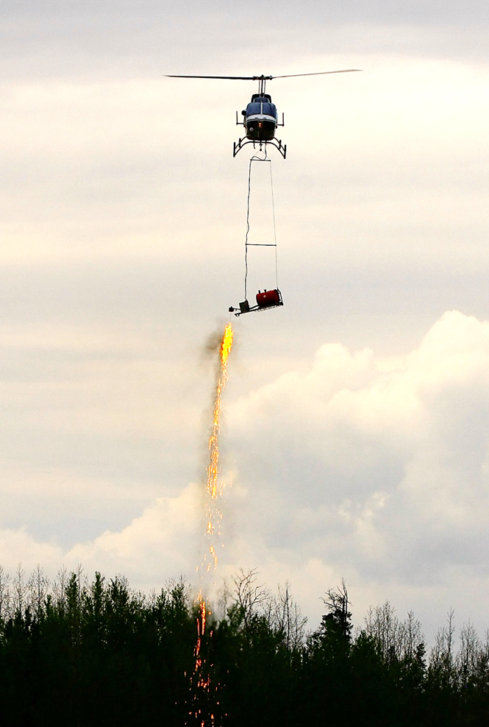
PSD vs. Helitorch Disadvantages
PSD vs. Helitorch
DISADVANTAGES
Fire Behavior
Spheres burn for a short amount of time
Ignition lines take longer to develop
Cannot duplicate helitorch intensity
Risk Management
Requires additional personnel on board
Possibility for a hang fire in the device
Device not easily jettisoned
Difficult to secure in the event of an emergency
Notes:
Fire Behavior:
More of an understory burn
PSD is unable to replicate the fire intensity created by helitorch;
Risk Management:
In helitorch operations, typically the pilot is the only person on board the aircraft, whereas in PSD operations there may be up to 4 personnel on board – the pilot, aerial ignitions supervisor, qualified PLDO and PLDO trainee.
The PLDO could experience device malfunctions that may lead to a hang fire in the device (hang fires will be discussed later on in the course). If the PLDO is unable to extinguish the hang fire they may need to jettison the device from the aircraft. If required to do so there is a specific series of steps and communication protocol to follow. The steps required, size and weight of the device may make it difficult to jettison from the helicopter quickly. (Steps for jettisoning the device will be covered later in the course)
In the event of an emergency, it is essential for the safety of the PLDO that their outboard leg is brought inside the helicopter, the device is secured, separation from the device maintained, and a crash position established in the event of a hard or crash landing. Additional information on emergency procedures will be covered in Unit 7.

Slide 14
UNIT 2 PSD Training, Qualifications & Responsibilities
Unit Objectives:
Discuss PLDO training and qualifications requirements
Identify aircraft and pilot carding procedures for PSD operations
Compare the differences in the PSD organization for prescribed fire and wildland fire
Explain identify PLDO position responsibilities

Slide 15
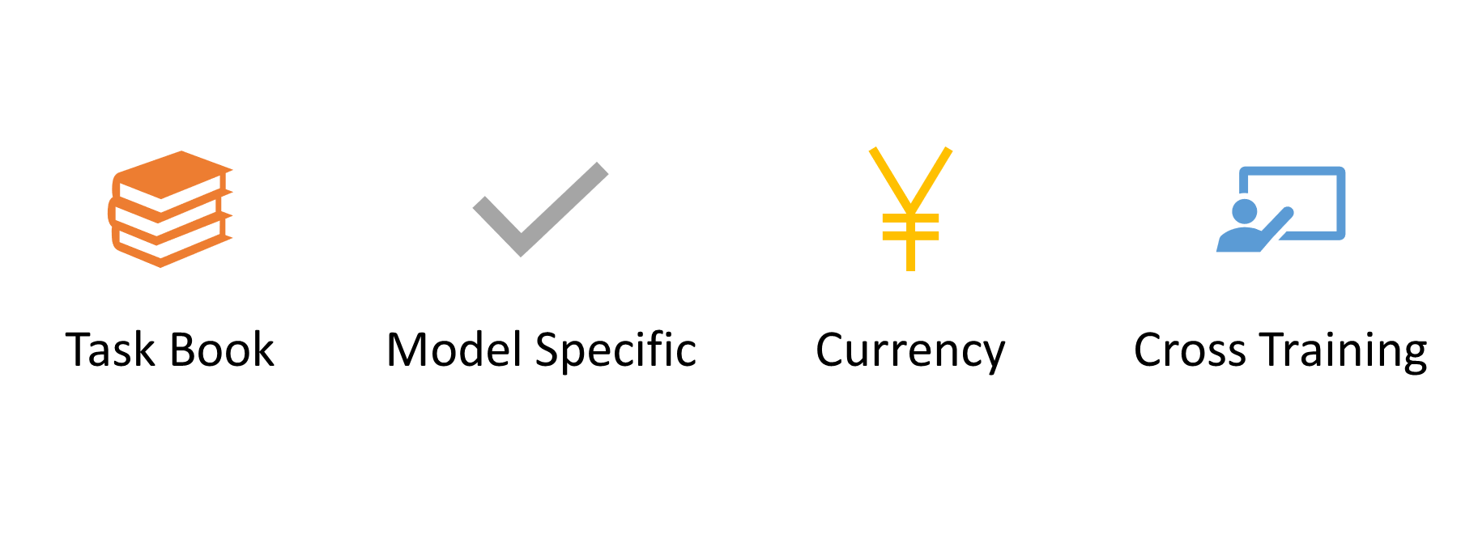
PLDO Training Requirements
Prerequisites:
IS-700, ICS-100, RT-130, A-110 (tri-annually)
Required Experience:
Satisfactory performance as Project Helicopter Crewmember OR Helicopter Crewmember (HECM) AND Completion and certification of PTB as a Plastic Sphere Dispenser Operator (PLDO)
PLDO Task Book & Additional Device: Complete w/1 device, additional training sheet for additional device or can it be completed using multiple devices
RT9016 annually following completion of N9016
Forest Service requires PLDO personnel to maintain currency as Helicopter Crewmember (HECM)
Notes:
PREREQUISITE REQUIRED TRAINING: An Introduction to the National Incident Management System (IS-700) An Introduction to the Incident Command System (ICS-100) Wildland Fire Safety Training Annual Refresher (WFSTAR) (RT-130) Aviation Transport of Hazardous Material (A-110 – Triennially).
REQUIRED EXPERIENCE: Qualified Helicopter Crewmember
Test Requirements: 70% for passing
Task Book: Completion of task book
Model Specific: Additional model specific training is required on any device not covered in initial training.
Cross Training: Device cross training will be documented on the Aerial Ignition Device Additional Training form found in PMS 501. This training may be completed in a classroom or in the field on a wildland or prescribed fire operation. A flight with the device to finalize additional device training is at the discretion of the instructor based on the PLDO’s knowledge and experience with PSD operations.
Currency: To remain current and qualified as a PLDO, personnel will need to attend an annual RT9016 session AND serve in the PLDO position at minimum once every three years

Slide 16
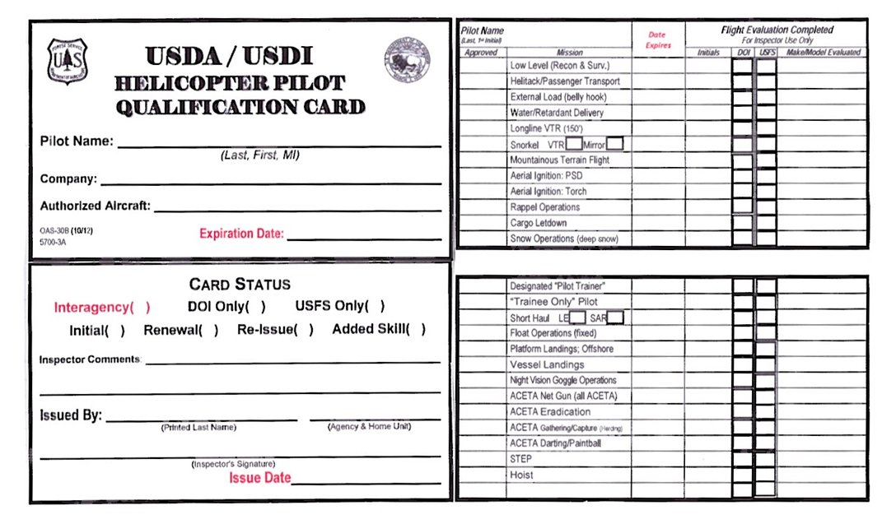
Pilot Training and Qualification Requirements
Pilot qualification card must be reviewed before a mission is flown!
Notes:
To become qualified for aerial ignition the pilot must be qualified for basic helicopter fire operations including recon and surveillance, helitack passenger transport and bucket operations. Each pilot must also complete the IAT A-110 Aviation Transportation of Hazardous Materials training online tri-annually. The pilot will then attend an initial PSD training (this training) and then may be give a verbal and/or flight maneuvers evaluation by a Helicopter Inspector Pilot (HIP).

Slide 17
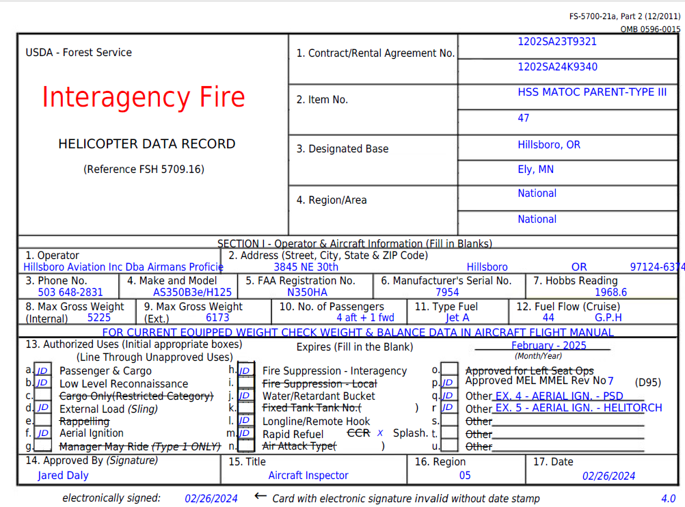
Aircraft Carding Requirements
The aircraft data card must be reviewed before a mission is flown!
Notes:
The aircraft will be inspected by an Aircraft Maintenance Inspector (AMI). All helicopters that will be used for PSD operations shall be equipped with a power source for the PSD device. Reference the wiring diagram in the aircraft contract and the PMS 501 for additional information.
PSD devices may be secured in the helicopter utilizing a belly strap or approved model specific hard points. If not using manufacturer’s belly strap systems, all other methods of securing the PSD device in the helicopter must be approved by an AMI.

Slide 18
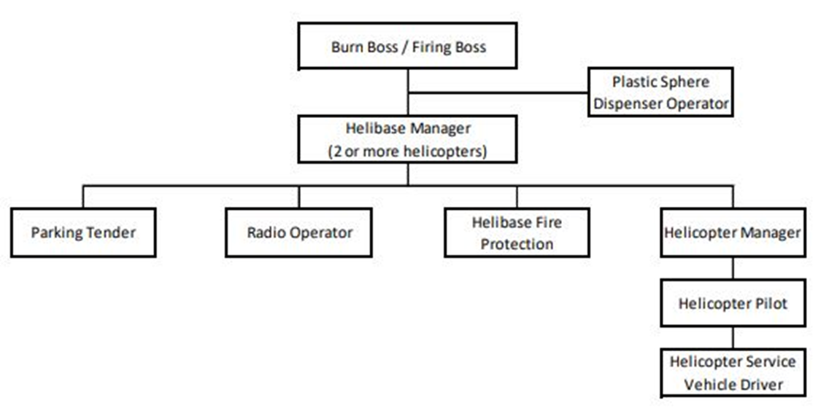
Prescribed Fire Operations
A FIRB, RXB1, or RXB2 may direct aerial ignition
Aerial Ignitions Organization
Notes:
Instructor Note: All required forms are located in Appendix A of the PMS 501. Instructors should show students where to locate the required forms online for PSD operations and have copies of each form available for them to reference throughout the course.
https://www.nwcg.gov/publications/pms501
*If utilizing a PSD scenario for the course, have students complete either a prescribed or wildland fire org. chart.
Aerial ignition operations must be overseen by a qualified supervisor – for prescribed fire operations, only a Firing Boss (FIRB), a Type 1 or Type 2 Burn Boss
(RXB1 / RXB2) may direct aerial ignition operations.
Depending on the complexity of the aerial ignition operations, users may elect to add additional helibase or helispot management or support positions, this may include: HEBM, ABRO or others deemed necessary for the operation.
*A helibase manager is required anytime there are two or more helicopters operating out of the same location and/or assigned beyond one day.
Personnel working under NWCG positions shall follow the Standards for Helicopter Operations (NSHO) and specific agency fire and aviation qualification standards.

Slide 19
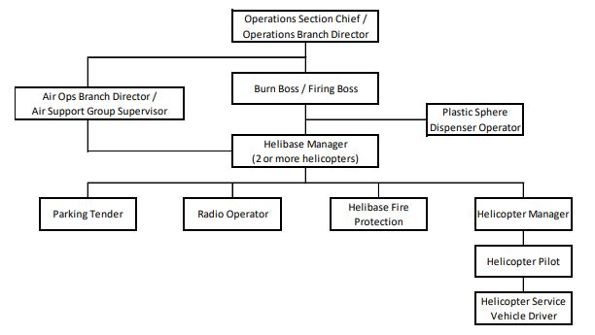
Wildfire Operations
An OSC, DIVS, FIRB, RXB1, or RXB2 may direct aerial ignitions
Aerial Ignitions Organization
Notes:
For a wildfire PSD operation, a Firing Boss, Operations Section Chief (OSC), Division/Group Supervisor (DIVS), Type 1 or Type 2 Burn Boss (RXB1 / RXB2) may direct aerial ignition operations.
Depending on the complexity of the aerial ignition operations, users may elect to had additional helibase or helispot management or support positions to include: HEBM, ABRO or others deemed necessary for the operation.
*A helibase manager is required anytime there are two or more helicopters operating out of the same location and/or assigned beyond one day.
Personnel working under NWCG positions shall follow the Standards for Helicopter Operations (NSHO) and specific agency fire and aviation qualification standards.

Slide 20
PLDO Responsibilities
Serves as PLDO for the aerial ignition supervisor. PLDO may have collateral duties as the HMGB.
Briefs pilot and identifies safety requirements at the operations briefing.
Monitors overall operation and provides information on aerial safety procedures to be used by the aerial ignition supervisor.
Prepares, installs, operates, maintains, and cares for the PSD.
Verifies for the aerial ignition supervisor that prescribed spacing of ignition is occurring and makes the necessary adjustments as directed.
Determines if malfunction occurs and acts accordingly.
Communicates with the pilot and aerial ignition supervisor on all procedures associated with operation and/or emergencies occurring during the operation.

Slide 21
HMGB Responsibilities
Position Responsibilities– Duties and responsibilities are outlined in NSHO. HMGB may have collateral duties as the PLDO or FIRB.

Slide 22
Pilot Responsibilities
The pilot will follow the ignition plan under the direction of the aerial ignition supervisor.
The pilot-in-Command is responsible for all matters related to
- aircraft operations and safety
- weight and balance
- performance planning
- PSD installation oversight
- helicopter load calculation
Notes:
Good communication and Crew Resource Management (CRM) is critical in making this operation work safely and effectively.

