Slide 1
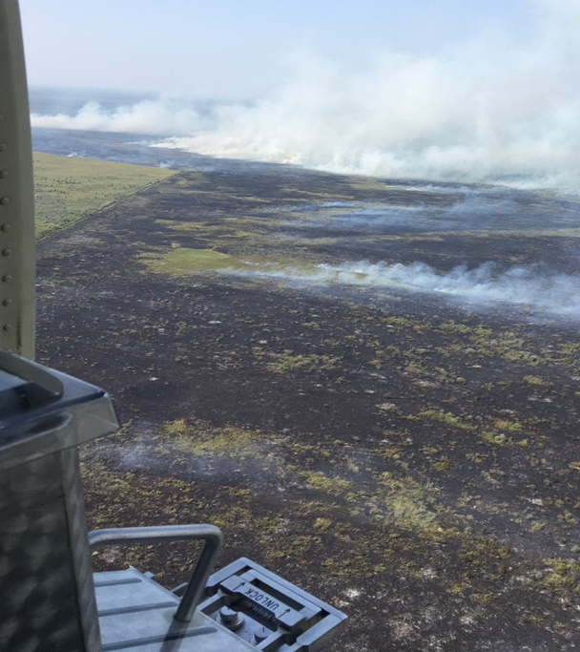
UNIT 6 Fuels and Fire Behavior
Unit Objectives:
Identify key elements of the fire environment
Review the three factors that drive fire behavior

Slide 2
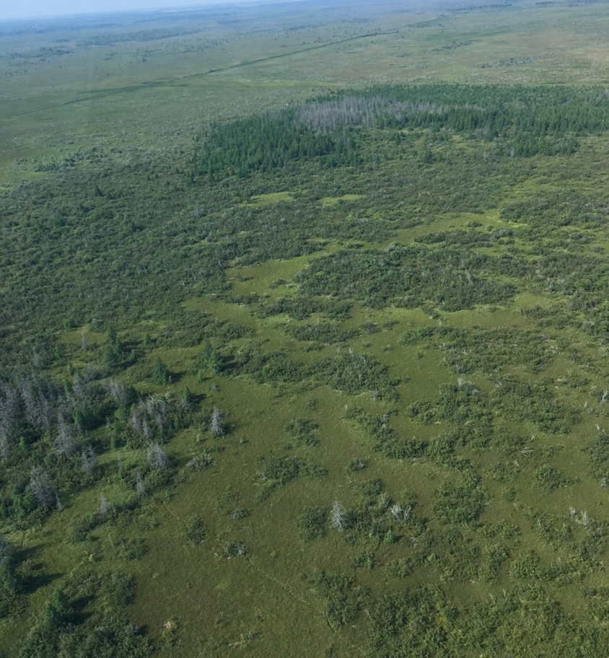
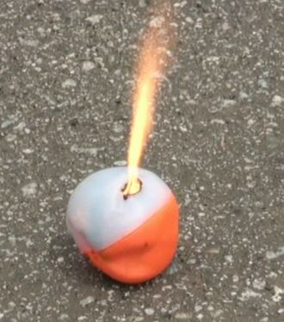
Fuels and Fire Behavior
Adjustments to firing patterns can be made to produce fire effects that will meet burn objectives.
Fuel Characteristics
Fuel type
Fuel moisture
Fuel load and continuity
Chemical properties
Notes:
Fuels, weather, topography and ignition patterns interact to create fire effects. Adjustments to firing patterns can be made to produce fire effects that will meet burn objectives.
It is important to recognize that the burn time of the PSD spheres’ burn time is limited, and each spheres’ burn intensity relatively low. Consideration of fuel characteristics is important for determining whether PSD is the correct tool for the job or how the tool will be used.
Things to consider:
If fine fuels are not available or fine fuel moisture codes (FFMC) are high, PSD operations may be ineffective. PSD will have limited success in areas of brush or heavy slash that do not have receptive ground fuels/fine fuels. The ratio of fine fuels vs. heavy fuels and fuel moisture content (live vs. dead) is important to consider when planning for aerial ignition operations.
Without continuous receptive fuel the spheres will be unable to grow together and develop, thereby potentially limiting spread and intensity. This is where spacing of spheres may be a consideration.
If more of a mosaic burn is desired, then use of PSD with higher moisture content fine fuels or without a continuous fuel bed may be desired

Slide 3
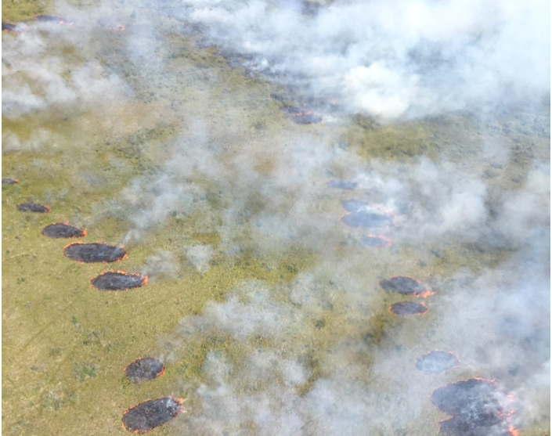
Fuels and Fire Behavior
Firing Techniques
Strip - Head
Strip - Backing
Flanking
Ring
Spot / Dot
Chevron
Center
Combination of all
Notes:
Ignition /sphere spacing is determined by the aircraft’s forward airspeed and altitude, the number of chutes (Premo Mark III), device speed (Premo Mark III – fast or slow, Red Dragon speeds 1 through 7), and wind speed and direction. When reviewing firing patterns ensure these factors are discussed with the aerial ignition supervisor. When going over firing techniques, reducing time in the “low and slow” should also be considered.
Strip or Head fire – a fire spreading with the wind or the slope. Highest intensity fire with long flame lengths, fast rate of spread, rapid heat buildup with substantial convection column, and shorter heat residence time than that of a backing or flanking fire. Spheres are laid in line of the wind and/or slope to so the fire could be pushed them.
Backing – a fire that is spreading against the wind or slope. Lowest intensity fire, smaller flame lengths, slowest rate of spread but longer heat residence time than a head or flanking fire. Spheres are placed so the fire can back into the wind or down the slope.
Flanking – a fire that spreads at right angles (perpendicular) to the wind or slope. A flanking fire has a slower rate of spread and lower intensity than a head fire, but it has a higher rate of spread with higher intensity than a backing fire. It has an intermediate heat residence time.
Ring – Lighting fire in a circular pattern around a specific object to minimize or exclude fire impact on the object. Or lighting fire in a circular pattern so the fire front converges towards the center, “ringing the unit.”
Spot / Dot – Igniting “dots” of fire (i.e., Premo Mark III two chutes and set to slow or Red Dragon on speed 1-2) to regulate intensity (increased or decreased).
Chevron – A variation of strip-head or flanking fire in which the strips resemble a V. This technique may be used to burn down a ridgeline or to widen a control line.
Center – Lighting fire in a circular fashion for the inside or high point of an area in an outward progression. Quickly generates high intensity fire. Typically utilized when winds are calm or light, and sufficient fuel loading is available..

Slide 4
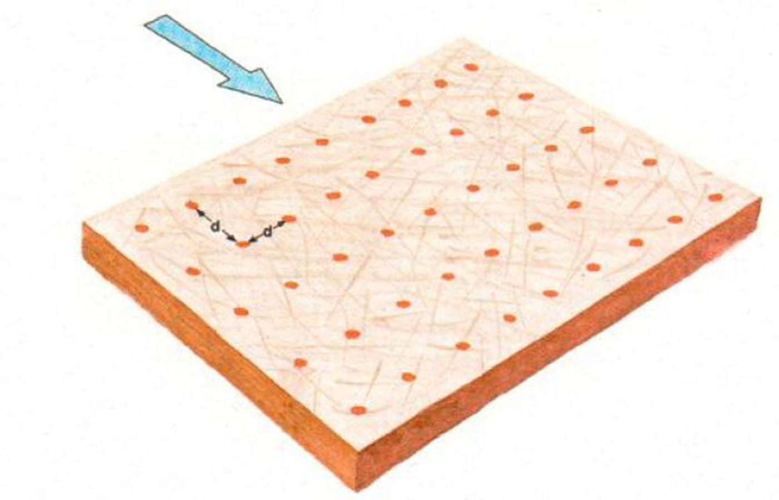
Fuels and Fire Behavior
Notes:
INSTRUCTOR NOTE: The blue arrow in this diagram depicts wind direction.
When sphere spacing is kept tight together, both within the ignition line and spacing between ignition lines there is limited space for the fire to accelerate, thereby creating a low rate of spread overall low intensity fire.
A great example of this is the picture on the previous slide; spheres were kept close together by running the Premo Mark III at 4 fast and ignition lines were also kept tight by flying narrower strips. As you can see in the picture this was completed near a road which was utilized as a holding line. This type of ignition allowed personnel to build depth (black) along the holding line while keep intensities lower and not “slamming” the holding and lighting resources on the ground located on the road.

Slide 5
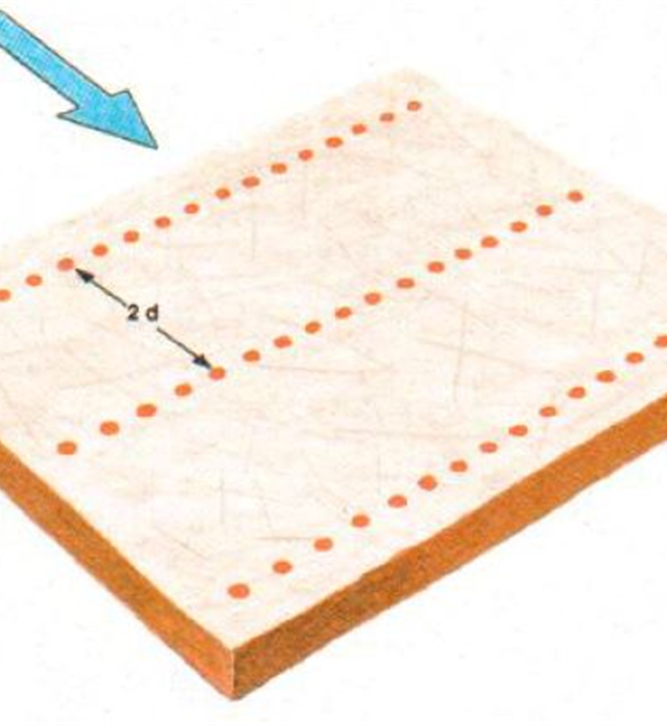
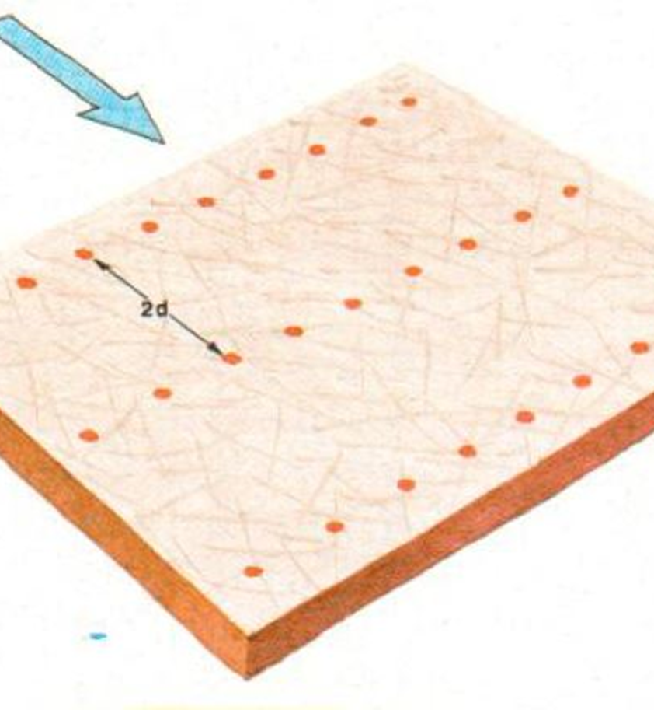
Fuels and Fire Behavior
Notes:
INSTRUCTOR NOTE: The blue arrow in this diagram depicts wind direction.
In the diagram on the left, the ignition lines are spaced further apart. This allows the fire to accelerate and develop, leading to greater fire intensity.
The line spacing and sphere spacing have been increased in the diagram on the right, leading to more significant development and fire intensity than shown in the diagram on the left.
Operators, aerial ignition supervisors, and burn bosses understand this concept, and realize that PSD ignitions take time to develop. It is easy to be tricked into putting too much fire on the ground if aerial ignition supervisors are not patient and do not allow the spheres to develop.

Slide 6
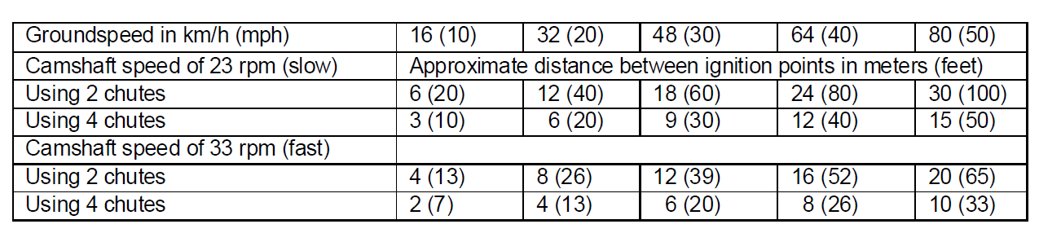
Fuels and Fire Behavior
Premo Mark III Ground Spacing
Notes:
INSTRUCTOR NOTE: Hide this slide if not training on the Premo Mark III.
This chart shows ignition (sphere) spacing as it relates to the aircraft’s groundspeed, number of feed chutes open, and motor speed (fast or slow).
Consider reviewing the chart with the PLDO, AIS, and pilot before operations.

Slide 7
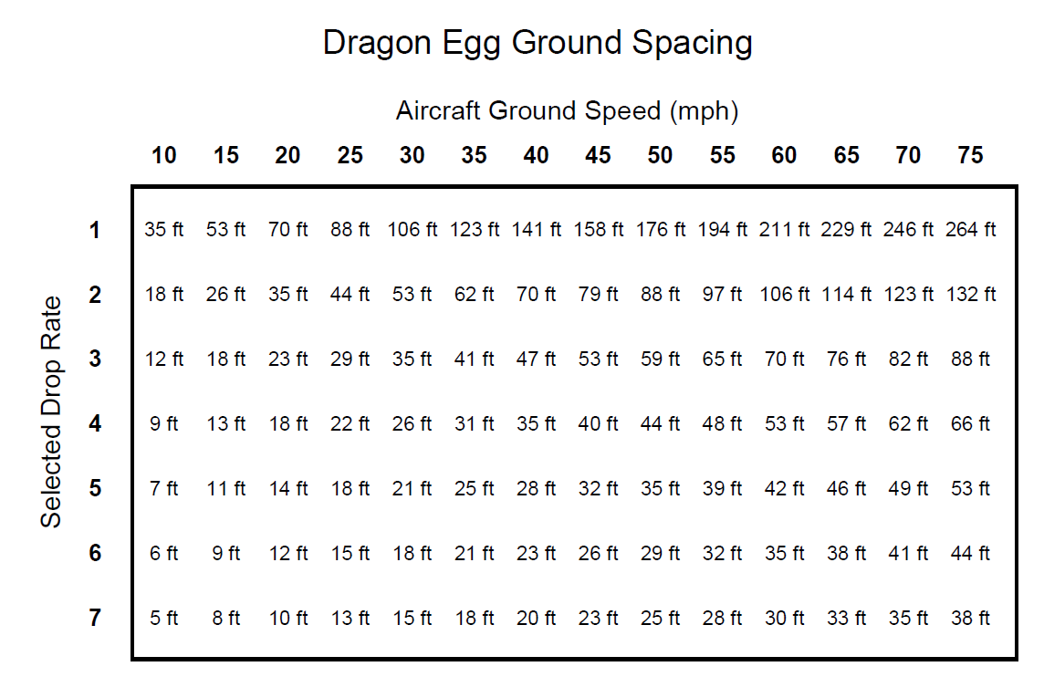
Fuels and Fire Behavior
Notes:
INSTRUCTOR NOTE: Hide this slide if not training on the Red Dragon
This chart shows sphere spacing as it relates to the aircraft’s groundspeed and the device speed selected.
Consider reviewing the chart with the PLDO, AIS, and pilot before operations.

Slide 8
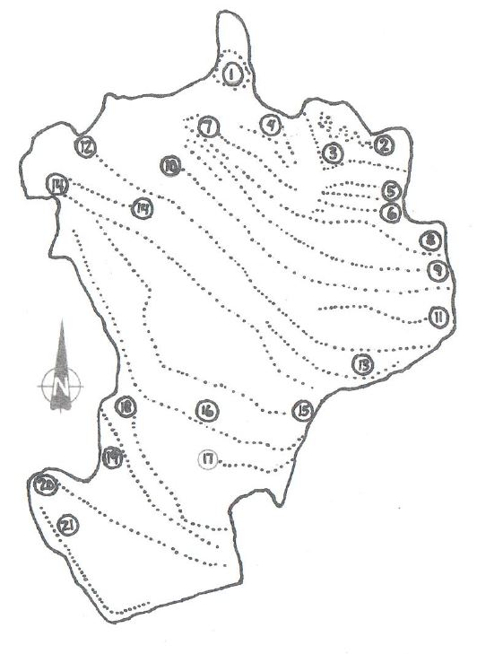

Example Burn Sequence
Notes:
This diagram shows a 2,359 acre burn unit and the order of ignition lines completed (numbered 1 through 21). The ambient wind direction on the burn was from the SW.
Instructors Note: Use the diagram to point out different firing patterns, the fire effects, and why.

